Slide 1


COMP507 IT Project Management (ITPM) Course Overview Daniel Vaipulu: Programme Director– Master of IT Project Management (MITPM)

Slide 2
Agenda
Why COMP507 (ITPM Course)
Teaching Team
Lecture and Lab Schedules
Course Assessments

Slide 3
COMP507- A core course & why it is critical?
IT project management (PM) knowledge and skills are now considered critical attributes of IT graduates and IT professionals
Our industry advisory committee has ensured COM507 is one of the core papers for the BCIS qualification
Industry is moving away from specialist to generalist individuals and into what is called ‘T-Skilled’ IT-type individuals
While the “specialist” project manager role is disappearing, project management tasks are becoming embedded in other IT roles and even more critical to delivering projects successfully.

Slide 4
COMP507- A core paper & why critical?
You will learn PM concepts (foundation)- it must remain with you forever as an IT person
We will teach PM knowledge areas (provide PM concepts)and, through the lab classes, provide the necessary PM skills
Our teaching will be based on PMI (Project Management Institute) concepts
PMI is one of the major professional (industrial) world bodies on PM
They provide best PM practices (PMBOK Guide) to successfully manage projects
Provide PM certification
COMP507 is industry-based teaching
On completion of COMP507, plus the other 2nd year papers relating to your major, you must have sufficient PM knowledge and skills to undertake the R&D project course (two-semester course- COMP702 & COMP703)
COMP702 & COMP703- another core BCIS course (30-points)
Undertake a client project with 3 to 4 other students in your team
Allocated project will be based on your major
Client projects are mostly industry-based, but we also have internal client projects
Each project team will have a mentor and moderator under the paper leader. Teams must work closely with their client

Slide 5
COMP507- A core paper & why critical?
COMP507- learn about projects and PM
10 knowledge areas & 5 process groups and various project plans
PM methodology- project phases, SE methods & practices & roles etc.
Lots of individual elements to learn to understand PM

Slide 6
Teaching team
Lecturer:
Daniel Vaipulu: daniel.vaipulu@aut.ac.nz
TA:
Khin Khin Maw: jjy3276@autuni.ac.nz
Sindhuja Selvaraj: Pdf8356@autuni.ac.nz
Adeola. Ojo: adeola.ojo@autuni.ac.nz
Manpreet Dhanjal: ggv5104@autuni.ac.nz

Slide 7
Teaching schedule
Lecture: Must attend the lecture(as allocated in your timetable)
Lecture 1: Monday 4-6 pm at WG403
Lab: attend one lab per week only (as allocated in your timetable)
Stream | Lab |  | Location
COMP507/W204A | 2:00 PM - 4:00 PM | TUES | WZ602
COMP507/W203A | 8:00 AM - 10:00 AM | THURS | WS220
COMP507/W201A | 2:00 PM - 4:00 PM | THURS | WS220
COMP507/W103A | 8:00 AM - 10:00 AM | FRI | WZ602
COMP507/W102A | 4:00 PM - 6:00 PM | FRI | WZ517

Slide 8
Topics Covered
Project knowledge and concepts - triple constraints, project attributes, project phases, project management methodology
Five process groups
10 knowledge areas:
- Project Integration Management
- Scope Management
- Scheduling/Time Management
- Cost Management
- Quality Assurance Management
- Communications Management
- Stakeholder Management
- Risk Management
- Human Resource (Team) Management
- Procurement Management

Slide 9






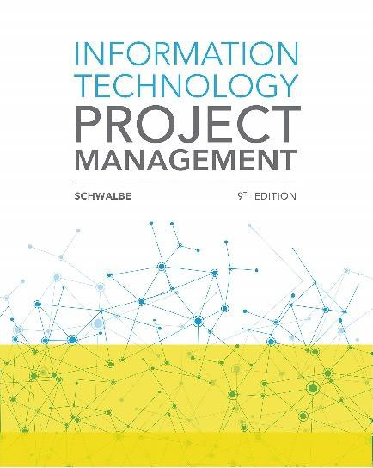
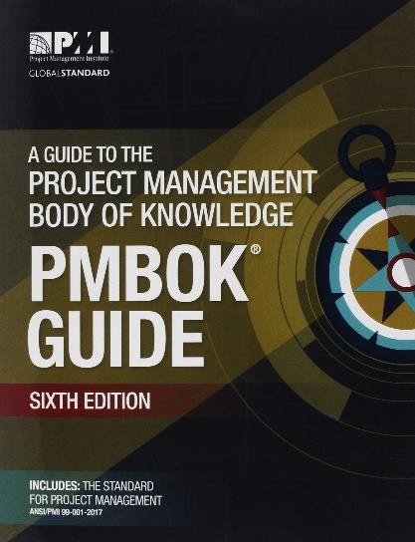
Text Book
1. REQUIRED! Information Technology Project Management (9th edition), By Kathy Schwalbe
2. Also A Guide to the Project Management Body of Knowledge
(PMBOK Guide) 6th Edition (available on AUT online)

Slide 10
Schedule
Week | Topic(s) | Assessment
1 | Introduction to IT PM
2 | Project Life Cycle & Phases | Introduction to Assignment 1 Part 1
3 | PM Process Groups, Integration
4 | Scope Management
5 | Stakeholder management
6 | Schedule management | Assignment 1 Part 1 Due 23rd August, Sunday, 11:30pm Introduction to Assignment 1 Part 2
7 | Guest lecture
8 | Communication management
9 | Quality management
10 | Cost management | Assignment 1 Part 2 Due Sunday: 10th May at 11:30 pm Introduction to Assignment 2
11 | Risk management
12 | Resource and Procurement management | Assignment 2 Due Week 12

Slide 11
Assessments
1. Assignment 1 worth 50% Team-based
a. Part 1- 25%
b. Part 2- 25%
2. Assignment 2 worth 50% Individual-based
IMPORTANT
You must attain a minimum of 35% mark or higher of the total allocated percentage of each of the assessments; and
Also, when the marks of all assessments are added together, you must have
attained an overall total of 50% or more to get a pass for this paper
Need to spend about 8-10 hours per week of your own time on this paper

Slide 12
Assignment 1: Team project
Assignment 1 (will be posted on the Canvas be end of week 2)
In this project, you will:
Form a team of Four members (from your same tutorial class)
choose a team leader- an individual who will lead the team in the communication and coordination side of things only; tasks and decision-making etc., must be done collectively
The team lead must email the team list to their Teaching Assistant by the end of Week 3
Full name of team members, Student ID, preferred email address
Team name

Slide 13
Assessments 1 Part 1 and Part 2
Assessment 1 Part 1 – Due date-due on 23rd August, Sunday, 11:30pm | Marks
1. Business case | 25
2. Stakeholder register | 5
3. Stakeholder management strategy | 10
4. Project charter including roles and responsibilities (must include a Team Leader) | 20
5. Team contract | 10
6. Kick-off meeting agenda and minutes | 5
7. Client meeting agenda and minutes | 5
8. Team meeting agenda and minutes (every other daily or weekly meeting’s agenda and minutes must be submitted) | 5
9. Risk register (version 1) | 5
10. Issue register (version 1) | 5
11. Milestone report (version 1) | 5
Assessment 1 Part 2 – Due Date -20th September, Sunday, at 11:30 pm
12. Communications management plan | 10
13. Change management plan | 10
14. Scope statement | 15
15. Work Breakdown Structure (WBS) | 20
16. Project schedule | 20
a. Schedule baseline showing originally planned activities and their durations and milestones
b. Network diagram
c. Critical path analysis with accompanying discussion on the critical path and changes
17. Risk register (version 2) | 5
18. Issue register (version 2) | 5
19. Milestone report (version 2) | 5
20. Lessons-learned report | 10

Slide 14
Assessments 2
Assessment 2 | Marks
Project Cost Control | 30
Project schedule development | 35
Project selection | 15
Perform a quantitative risk analysis | 20

Slide 15
Team Information Template
Team Name | Last Name | First Name | Student ID | AUT/Preferred Email | Contact Number | Group Coordinator/ Leader
Remember: There is no ‘I’ in team. You will be jointly and severally accountable for team
outcomes – everyone named shares responsibility equally.

Slide 16
Learning Outcomes
Must have solid knowledge and understanding of project management
Able to understand and apply project management concepts (based on Project Management Institute (PMI) concepts)
Explain the principles of project management in an information technology context.
Compare and contrast project management methodologies and their applicability.
Compare IT project management practices in the management of integration, scope, time, cost, quality, human resources, communications, risk management, procurement and with stakeholders.
Apply project management practices, particularly in planning and communications
Use project management techniques to support planning, scheduling and estimation
Discuss the competencies for project management tasks enabling high-performing project teams.
Know how to develop a project proposal (develop plans for the project)
Know how to execute, monitor and control an IT project
Use typical project management software to organise, execute and control a project

Slide 17
Learning Outcomes
This paper also assists in:
Providing knowledge to produce a project proposal. Will come in handy for your R&D project (Level 7, 30 points) – to undertake an industry-based project and in your future careers.
What you will learn is used in industry - PMI’s 10 knowledge areas and 5 process groups will not change regardless of IT solutions, methods and infrastructure requirements.
The R&D project will further build your industry knowledge, including your project skills - you will have the reality and experience for undertaking an industry project to deliver a good interview when job hunting.

Slide 18
Techniques and tools (plans and documents)
The Business Case
Requirements document
Scope Statement document
Work Breakdown Structure (WBS)
Stakeholder register and stakeholder management strategy document
Project schedule, arrow diagram, network diagram
Communication plan
Quality Assurance plan
Budget plan - Earned Value Management (EVM)
Risk plan- qualitative and quantitative approaches - register and risk calculations, risk management
Issue management- issue register
We will introduce you to PMI templates for the above plans and documents

Slide 19
Tutorials in Labs
Tutorials tasks based on the topics covered each week.
Tutorial task – should take around 30-50 minutes
Assignment 1 tasks (Team assignment) – the rest of the time (an hour+) must be spent on the team assignment
Team assignment is based on creating various project plans and documents
to undertake IT project
Tutorial tasks should be done individually
Assignment 2 will be an individual effort and will be based on the tutorial tasks.

Slide 20
Academic integrity + bullying behaviour
Acts of academic dishonesty
copy from, or inappropriately communicates with, another person or is found in possession of any unauthorised equipment or material
plagiarize (copy) the work of another person without indicating that the work is not
the student’s own
collaborate with others in the preparation of material, except where this has been approved as an assessment requirement
resubmit previously submitted work without prior approval of the Assessment Board or a delegated authority
use any other unfair means
Any such acts will result in an appropriate adjustment of the assessment mark (i.e., 0), and it may lead to disciplinary action, failure of the course and potential expulsion from the BCIS programme
No bullying or any other actions aimed at harming or harassing anyone.
This not be tolerated even for a second; you will be gone from AUT & potential criminal charges will follow

Slide 21
Out-side-class contact
Who should I contact?
Your first point of contact is your Teaching Assistant
Khin Khin Maw: jjy3276@autuni.ac.nz
Sindhuja Selvaraj: Pdf8356@autuni.ac.nz
Adeola. Ojo: adeola.ojo@autuni.ac.nz
Manpreet Dhanjal: ggv5104@autuni.ac.nz
Email the lecturer (Daniel) to make an appointment
Contact: Daniel.Vaipulu@aut.ac.nz

Slide 22
Homework
Week 1 readings - Chapters 1 and 2 from Information Technology Project Management (2019) by Kathy Schwalbe.

